Slide 1
BONUS TASK - 1
Prepared by-
Sayam Kumar
Section - A
Roll No - S20180010158

Slide 2

A compiler is a computer program that converts the program written in high-level language into computer understandable machine-level language.
COMPILERS
To instruct the dumb computer.
Impossible for us to code using only binary language i.e. 0’s and 1’s.
Need of
compilers

Slide 3
Variety of C Compilers
It is an open source, cross platform and extensible IDE for C. It is used by most of the C programming students now a days.
It is also an open source compiler built for Linux users with some extra in built features.
Code::Blocks
Eclipse
Turbo C is an integrated development environment (IDE) for C programming. Remembered for compact size and fast compile speed
NetBeans is another open source compiler with features such as good highlighting, unit testing etc.
Turbo C
NetBeans

Slide 4
The classic open source C compiler for Linux and many other operating systems (and Windows under Cygwin or Ming), a project that has been around forever and supports all in-built features.
MinGW
MinGW compilers provide an open source compiler suitable for windows.
GCC
It is used for Mac operating system and iPhone and is owned by Apple. It also uses standard GCC compilers for C programs.
Xcode

Slide 5
Compiler Mountain
Instruction Selection
Type Checking
Register allocation
Parsing
Code generation
Lexing
Assembler Linker

Slide 6
What Does a C Compiler DO?
After generating the machine code, CPU understands it and then execution takes place. As it is clear from the above mountain, the various parts of a compilation process are-
Lexing - It breaks up the text of the program into "tokens". The tokens are the "words" of the programming language, such as identifiers or operators.
Parsing – It converts the sequence of tokens into a parse tree called AST(Abstract Syntax Tree), which is a data structure representing various language constructs: type declarations, expressions, etc.
Optimization – It evaluates constant expressions, optimizes away unused variables or unreachable code, unroll loops if possible, etc. and then after register allocation and linking the standard library files, execution takes place.

Slide 7

History of C Compilers
The first compiler was created by Carrodo, in 1951. The term compiler was coined by Grace Hopper., referring to her A-0 system which functioned as a loader or linker.
The FORTRAN team led by John at IBM introduced the first commercially available C compiler, in 1957, which took 18 person-years to create.
After years of evolution of C Compilers, today we are having multiple Compilers to choose one of them as our best partner!

Slide 8

Different Outputs in Different Compilers
Different outputs occur in different compilers when a C programmer uses undefined behavior and the compiler has to guess on its own what to do!
Example-
void main()
{
int a=2,b=3;
printf(“%d %d %d ”, a==b , a=b , a<b);
}
Outputs in-
Xcode = 0 3 0
Dev C++ = 1 3 1
Online compilers = 1 3 0

Slide 9
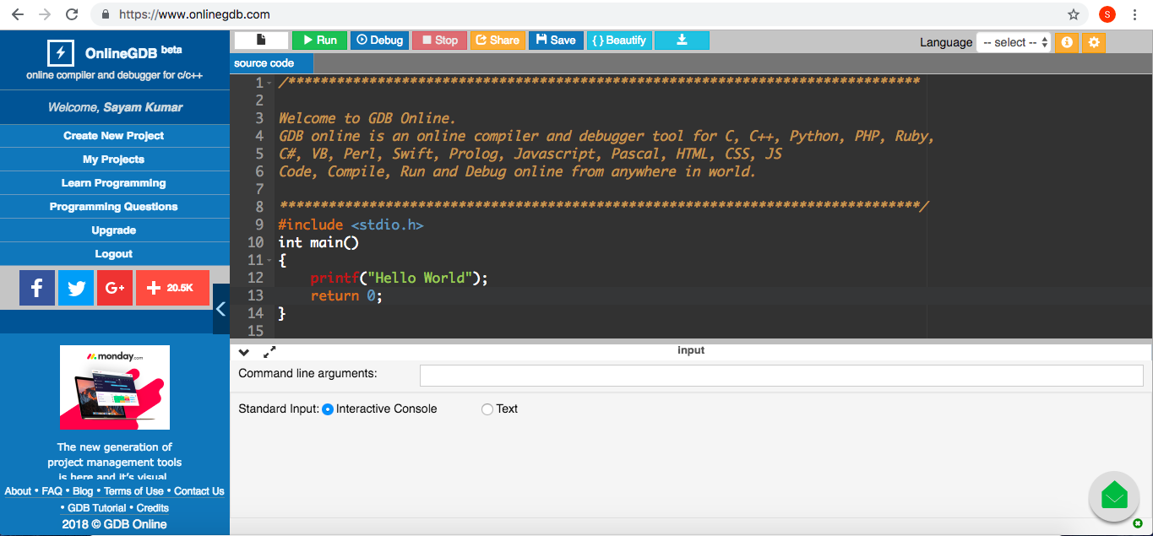
My Favorite C Compiler

Slide 10
Features of My Favorite Compiler
Easy to use – Only 6 Options Run, Debug, Stop, Save, Beautify and Download.
Can execute any programming language.
Provides an option to create and edit projects.
Save my projects and source code online.
No need to install different softwares for different languages.
Helps me to build logic and write syntax accordingly.
I also practice programming questions on this platform.
I will recommend everyone to use this awesome website and enjoy programming.
Link- www.onlinegdb.com

Slide 11
THANK YOU !!

